Slide 1
SEEM3550 Fundamentals of Information Systems
Tutorial 1 – Assignment 1
Prepared by Zijin Feng

Slide 2
TA Information
Last Name | Tutor | Tutor's Email
ALQAISSIAH - CHENG | Bian Tian | tbian@se.cuhk.edu.hk
CHEUNG - GENG | Feng Zijin | zjfeng@se.cuhk.edu.hk
HE - LEE | JIANG Yuli | yljiang@se.cuhk.edu.hk
LEUNG - PORNKASEMKUN | LO Chun Hei | chlo@se.cuhk.edu.hk
RAO - USTYANTSEV | PIAO Chengzhi | czpiao@se.cuhk.edu.hk
WANG - ZHOU | TAN Jie | jtan@se.cuhk.edu.hk
Please contact your corresponding tutor regarding any questions in lab and written assignments, using email subject ”SEEM3550A"

Slide 3
Basic Information
What is it about: this assignment is on SQL (Chapter 3)
Due date: 17:00 pm, March 11, 2022
Where to submit: Blackboard
What is the late penalty policy: the late penalty will be 10% each day, a submission will not be accepted five days after the deadline
How to contact the corresponding TA: send email to your corresponding tutor

Slide 4
Goal of this tutorial
Clarify some definitions/concepts in chapter 3 that are covered by this assignment
For more details, please refer to lecture notes, textbooks, google

Slide 5
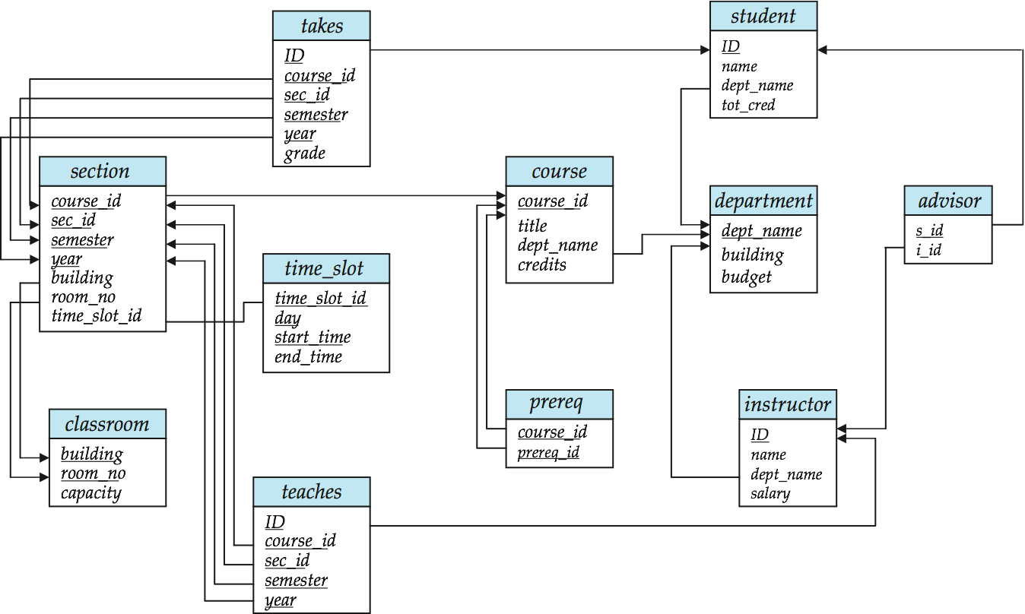
Question 1
Consider the 4 relations: student, takes, section, and course in the relational database schema (the slide 3.13 in ch3.ppt)
ID is a foreign key, from takes to student
course_id is a foreign key,
from section to course
course_id is a foreign key, from takes to course

Slide 6
Question 1
What are they?
takes: who (ID) takes which section (sec_id) of what course (course_id) in which semester (semester) in which year (year) and get what grade (grade)
student: student (name) with ID (ID) comes from which department (dept_name) and has got how many credits (tot_cred)
ID | course_id | sec_id | semester | year | grade
7 | 3550 | 1 | 1 | 2018 | A
8 | 2100 | 1 | 2 | 2018 | B
ID | name | dept_name | Tot_cred
8 | ABC | SEEM | 10
7 | XYZ | SEEM | 20

Slide 7
Question 1
What are they?
course: a course (course_id) has title (title) is held by which department (dept_name) and has how many credits (credits)
section: a section (sec_id) of a course (course_id) is held in which semester (semester) in which year (year). The location is in which room (room_no) of which building (building) and what is the time (time_slot_id)
course_id | title | dept_name | credits
3550 | DB | SEEM | 3
2100 | Algo | CSE | 3
course_id | sec_id | semester | year | building | room_no | Time_slot_id
3550 | 1 | 1 | 2018 | ERB | 401 | 3
2100 | 1 | 2 | 2018 | ERB | 402 | 4

Slide 8
Question 1
For each student, find his/her ID and name.
SELECT ID, name
FROM student
For each course, find the course ID and title.
SELECT course_id, title
FROM course

Slide 9
Question 1
?
?
For each course that be held in Spring semester in year 2022, find the course ID.
SELECT course_id
FROM takes
WHERE semester = ‘Spring’ AND year = 2022
or
SELECT course_id
FROM section
WHERE semester = ‘Spring’ AND year = 2022

Slide 10
Question 1
?
?
For each course be held in Spring semester in year 2022, find the course ID and title.
SELECT course_id, title
FROM course natural join section
WHERE semester = ‘Spring’ AND year = 2022
or
SELECT course, title
FROM course natural join takes
WHERE semester = ‘Spring’ AND year = 2022
Find student information (i.e., ID and name) and the course information (i.e., course id and course title) they took in Spring Semester (‘Spring’) in year 2022. Try it in asg 1

Slide 11
Question 1
Join
Cartesian product
SELECT *
FROM instructor, teaches
Cartesian product generates every possible instructor – teaches pair, with all attributes from both relations
Natural join
SELECT *
FROM instructor NATURAL JOIN teaches
Natural join matches tuples with the same values for all common attributes, and retains only one copy of each common column

Slide 12
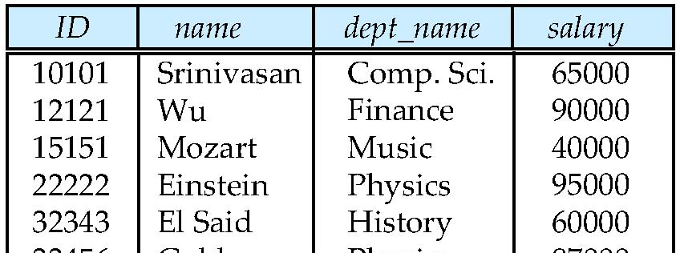
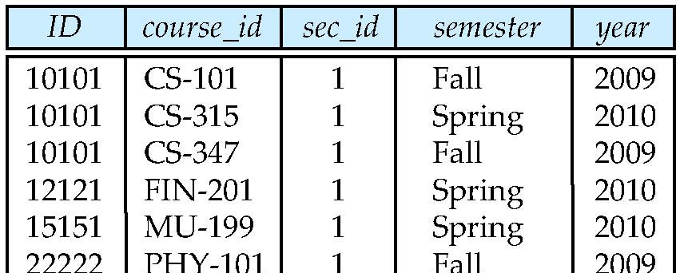
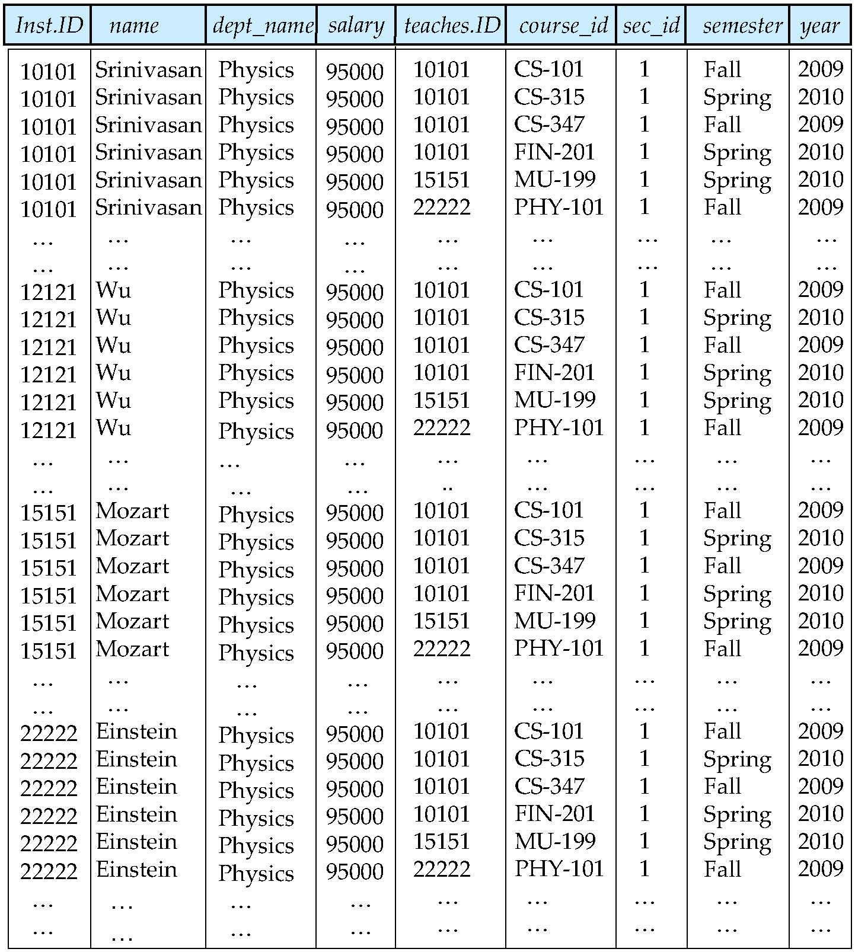
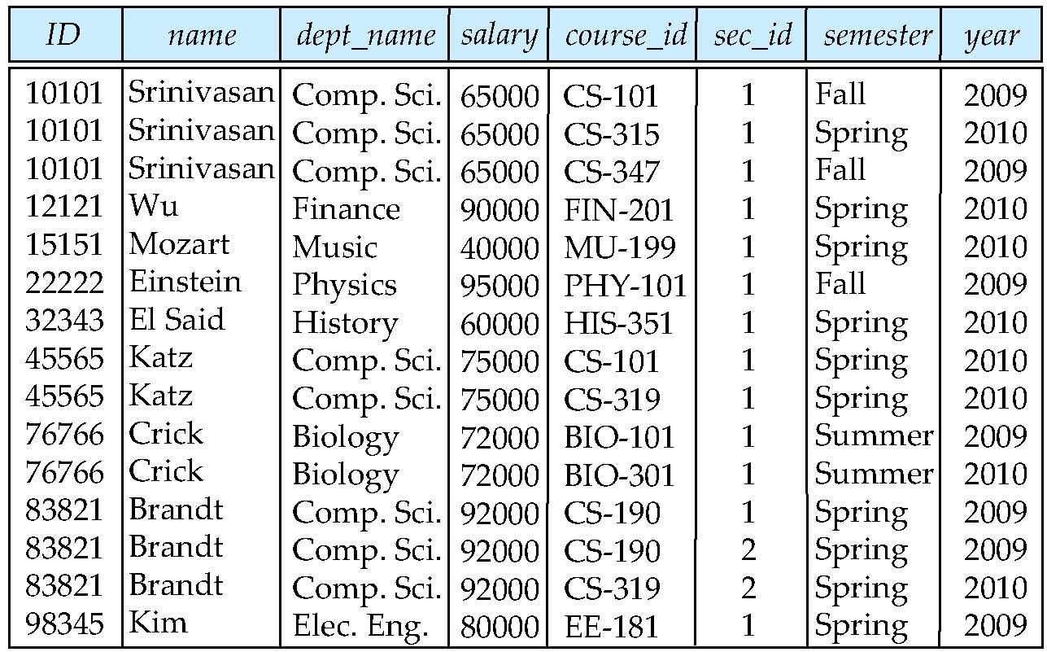
Question 1
instructor
teaches
Cartesian product
Natural join

Slide 13
Question 1
Relationship between Cartesian product and natural join
Cartesian product
SELECT *
FROM instructor, teaches
WHERE instructor.ID = teaches.ID
Natural join
SELECT *
FROM instructor NATURAL JOIN teaches
Give same results

Slide 14
Question 2
Consider the following query: “Find IDs of students who take the courses offered in Spring Semester (‘Spring’) in year 2022 and get at least one grade ‘A’ or grade ‘B’.
Answer this query using set operations.
Answer this query using joins and selections. You should not use nested SQL or derived relation.
Answer this query using a nested query with correlation variables.
Answer this query using a nested query without correlation variables.
Answer this query using derived relations.

Slide 15
Question 2
Find IDs of students who take the courses offered in Spring Semester (‘Spring’) in year 2022 and get at least one grade ‘A’ or grade ‘B’.
What tables we need?
?
?
?
?

Slide 16
Question 2
Find IDs of students who take the courses offered in Spring Semester (‘Spring’) in year 2022 and get at least one grade ‘A’ or grade ‘B’.
What table(s) do we need?
!
Use table takes is enough

Slide 17
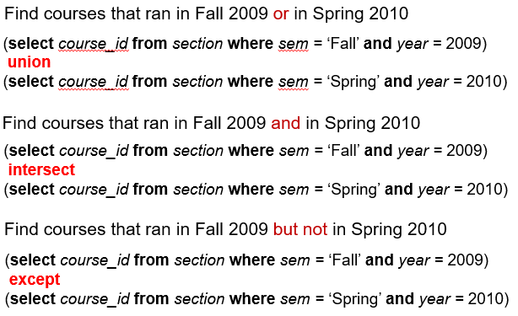
Question 2
Set operations
E.g., union, intersect, and except

Slide 18
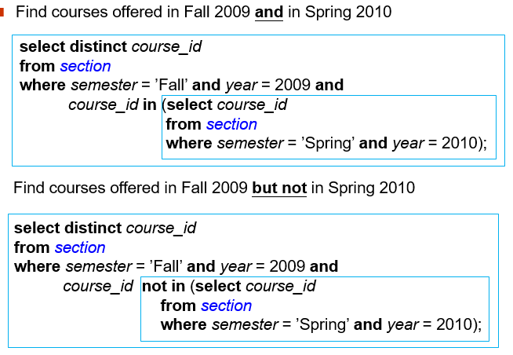
Question 2
Nested Subqueries
A subquery is a select-from-where expression that is nested within another query.

Slide 19
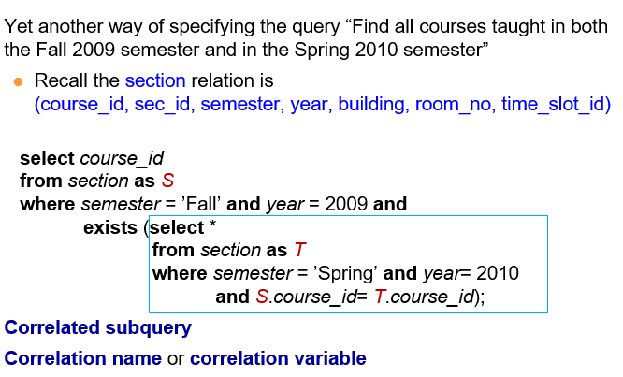
Question 2
Correlation Variables

Slide 20
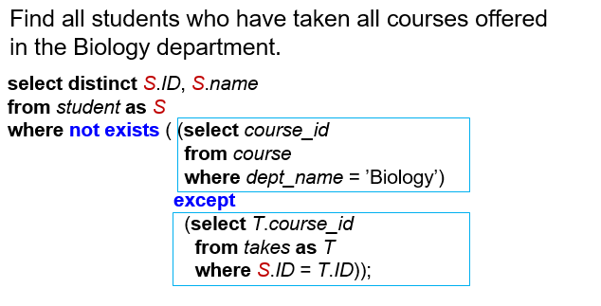
Question 2
Correlation Variables

Slide 21
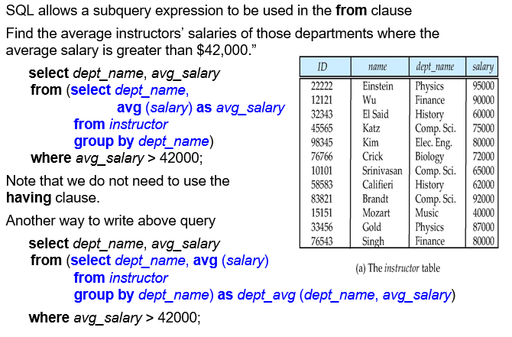
Question 2
Derived Relations

Slide 22
Question 3
Consider a query to find the course IDs, course names in Spring Semester (‘Spring’) in year 2022 and number of students in each course.
Give your answer using aggregate function.
Consider a query to find the department names and the number of students in each department. One possible answer is as follow. Is it correct? Give your reason and give the correct query if it isn’t.
SELECT dept_name, count (DICTINCT name)
FROM student
GROUP BY dept_name

Slide 23
Question 3
Consider a query to find the course IDs, course names in Spring Semester (‘Spring’) in year 2022 and number of students in each course.
What table(s) do we need?

Slide 24
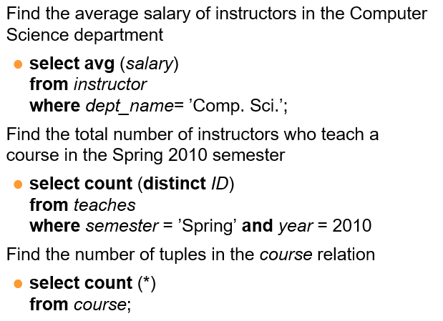
Question 3
Aggregate functions
avg: average value
min: minimum value
max: maximum value
sum: sum of values
count: number of values

Slide 25
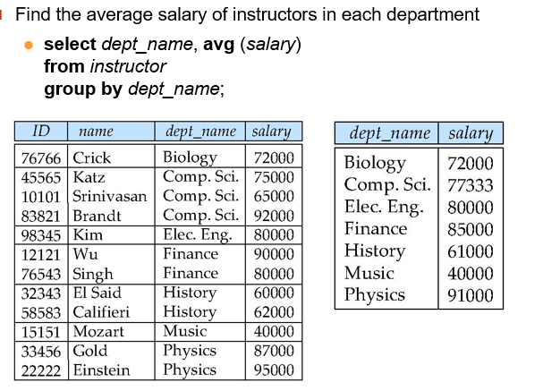
Question 3
Aggregate functions

Slide 26
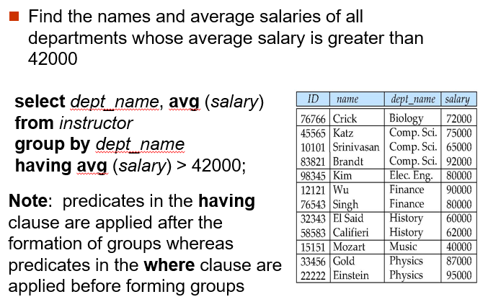
Question 3
Aggregate functions – Having Clause

Slide 27
Question 4
Answer the following questions using SQL statements.
Show student names, if she/he does not have an advisor assigned yet, assuming that a student may not always have a advisor.
Show the names of the instructors whose name include the substring “abc” or end with “d”.
Show the ID and name of all students having the highest total credits in the “SEEM” department.
For all buildings having total capacity (sum of the capacities of rooms in a building) greater than 1000, show their names and total capacity of each of them.
Show student names, if she/he does not has an advisor from ‘SEEM’ department. Assuming that a student may not always have an advisor.
For each department, show both the department budget and the remaining department budget after paying all its instructor’s salaries.

Slide 28
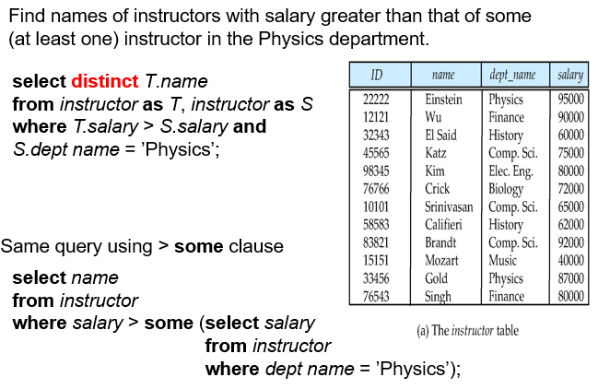
Question 4
Set comparison

